Slide 1
Drupal Basics
Santosh Kalwar
25.08

Slide 2
Drupal Recap
What we studied
Some lando commands, practices 1-12, concepts, docs, YAML
We created a very simple custom theme
Today topics
Improving our custom theme (a bit)
Creating a very basic custom module
Practising creating a very basic custom module
Installing the devel plugin and exploring Drupal UI
(if time else continue next time)

Slide 3
Improving our custom theme
Open your icecream theme info.yml file
Change base theme: false
Add semVer to your theme
Add regions: header, menu
Open your icecream libraries yml file
Create a new folder inside icecream_theme folder called “templates”
Inside “templates” folder, create a file page.html.twig
Inside page.html.twig, add {{ page.header }}
https://www.drupal.org/docs/theming-drupal/sub-theming-using-stablestable-9-as-a-base-theme

Slide 4
Improving our custom theme
Clear cache, lando drush cr
Check Structure->Block layout→ Demonstrate your theme regions
What do you see?
Repeat step 4 from previous slide with adding new region e.g. content
Repeat step 8 from previous slide with , add
{{ page.content }}
Repeat step 4 and 8 again by adding a new region e.g. sidebar, {{ page.sidebar }}
Repeat step 4 and 8 again by adding a new region e.g. footer,
{{ page.footer }}

Slide 5
Improving our custom theme
Add custom block inside or drag and drop block
from header to specific regions
In Structure → Block layout
Inspect and check the block regions using Inspector
Create a <div> with an id e.g. “header”, “content” and “footer” and wrap twig actions in page.html.twig
Note: Remember to clear cache every time you make changes either through GUI or through lando drush cr command

Slide 6
Why create a custom module?
In most use cases, you will never have to create a custom module
There are already 49k+ modules created by Drupal communities
Search from here: https://www.drupal.org/project/project_module
We will learn to create them to understand
How Drupal inner core work
The real power of Drupal is unleashed when you can create custom modules and themes based on your needs.
Our course name is “Drupal Module Development.”
We will create 4-7 custom modules max
Some popular modules we will download and use
See how they work and explore

Slide 7
Creating a very basic custom module
Step 1: Create a folder; where?
Step 2: Name the folder, e.g. first_module
The name of your module should never start with uppercase
No spaces between words
Step 3: Attract the attention of Drupal core by creating the first_module.info.yml file
Step 4: What will you require to create a page?
Remember Symfony ( in Drupal 9 case Symfony 4/5)
What + what equals a page?

Slide 8
Creating a very basic custom module
Step 5: Create a routing.yml e.g. first_module.routing.yml
Step 6: Create a controller
Step 7: Add a controller class
Step 8: Add a public method
Step 9: Check from your Drupal site, Extend menu
Step 10: Visit the /first/page,
Page Not Found, error ---- Good!
Step 11: Clear cache
Step 12: Visit again, success ---- Good!

Slide 9
Practising creating a very basic custom module
Create your basic custom module
Name your module as per your wish
Follow previous slides and steps
Remember Symfony: ? + ? = a page
Ask questions
Commit your changes to GitHub
Extra: Can you update your basic custom module controller class with render array StringTranslationTrait?
https://api.drupal.org/api/drupal/core%21lib%21Drupal%21Core%21StringTranslation%21StringTranslationTrait.php/trait/StringTranslationTrait/9.0.x

Slide 10
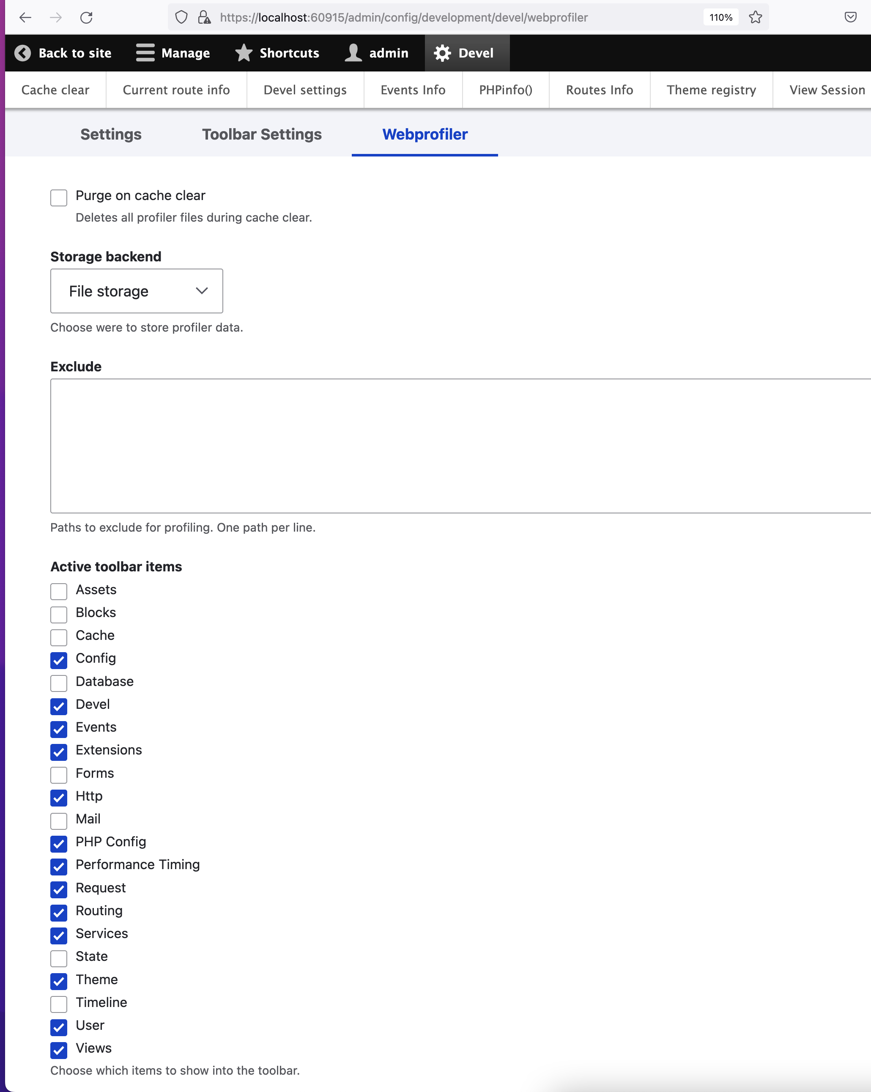
Devel and Webprofiler
Drupal’s well known Devel module contains a toolbar especially for developers install the module and enable Webprofiler.
Webprofiler is a tool for using while developing. It indicates the current route, the load time of the controller and a lot of other stuff.
https://git.drupalcode.org/project/webprofiler

Slide 11
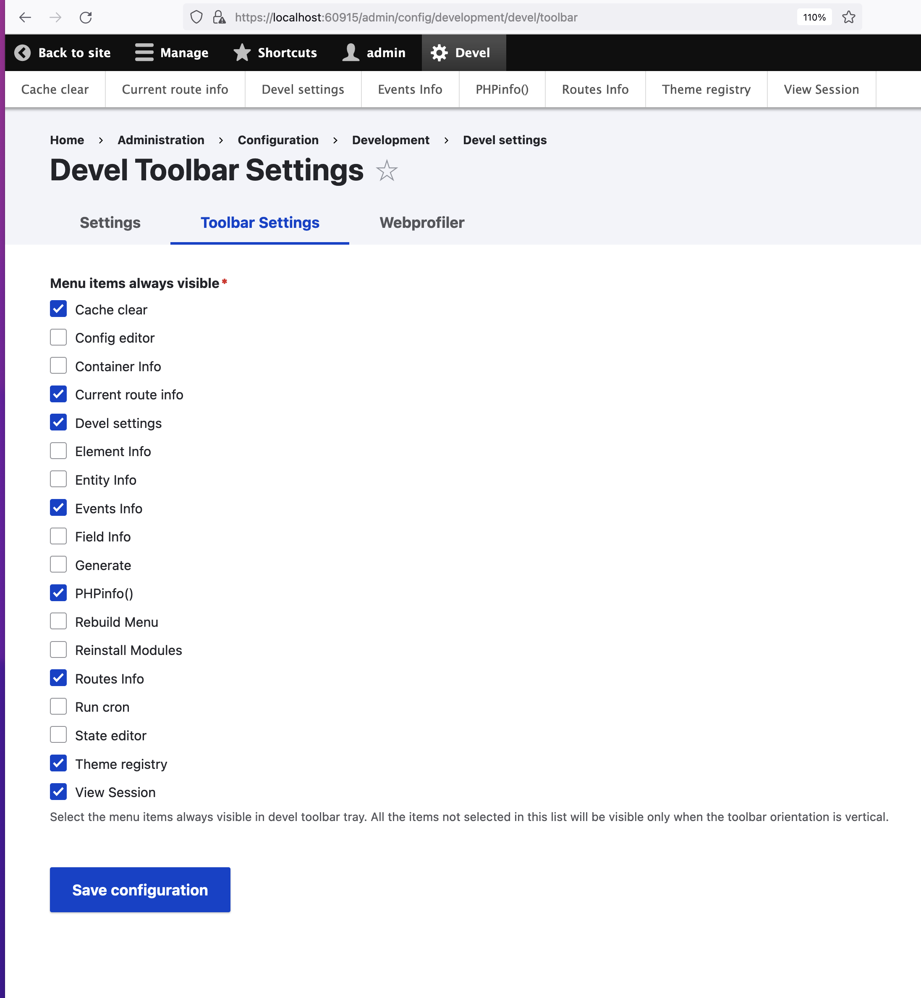
Installing the devel plugin and exploring Drupal UI
Devel is used for drupal development
lando composer require 'drupal/devel:^4.1’
lando drush en webprofiler
lando drush en devel
Select Devel menu toolbar settings
Enable Devel menu items
Save configuration
Search for Routes info
Find your custom module route
https://www.drupal.org/project/devel

Slide 12
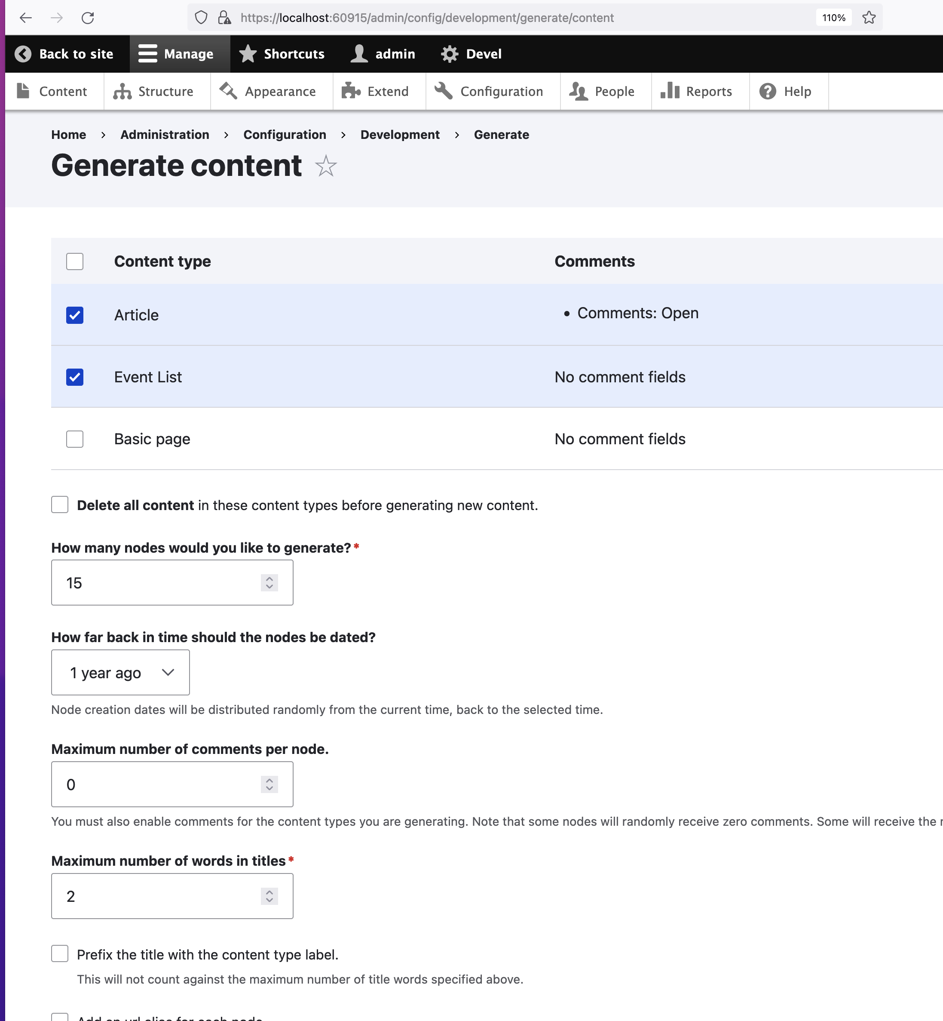
Creating content automatically with Devel generate
Enable devel generate from Extend menu
Go to Configuration→ Generate Content¨
Select Content type: Article, Event List
Add how many nodes you will like to generate: 15
Max. number of words in the title: 2
To find out if it worked, go to Content
You should see all generated contents
https://gitlab.com/drupalspoons/devel/-/tree/4.x/devel_generate

